Slide 1


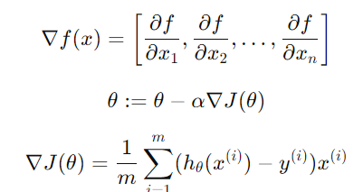
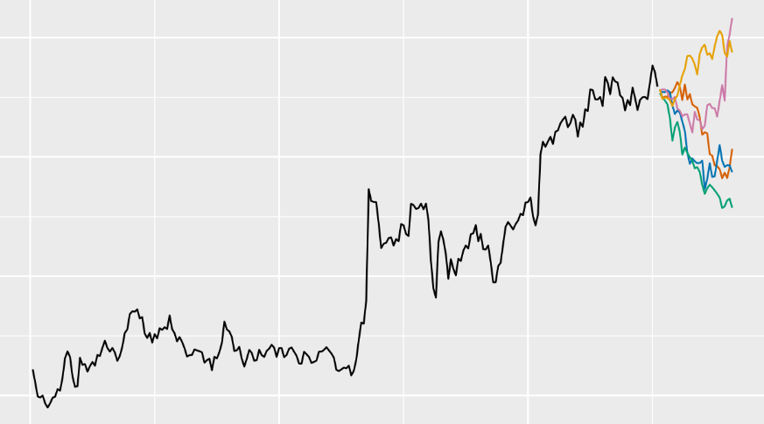


Probabilistic Forecasts with Global Gradient Boosted Decision Trees: Rethinking Bootstrapping with Structural Adjustments
Gradient!
Filotas Theodosiou, Yves R. Sagaert, ¹
VIVES University of Applied Sciences, Kortrijk, Belgium
Notes:
Hi everyone, I am Filotas Theodosiou, I am a Data Scientist and Researcher at VIVES University of Applied Sciences and this is our joint work with Yves Sagaert and Liselot De Vlieger.

Slide 2
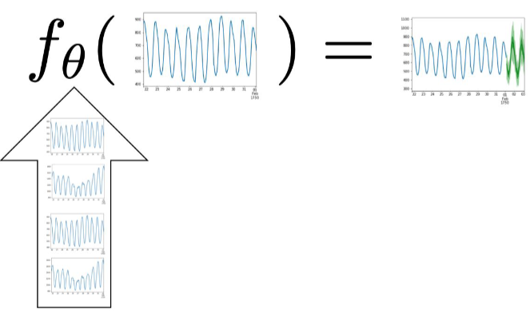
Probabilistic Forecasts with Global Gradient Boosted Decision Trees
“How to Learn”
Per series (local) is limited to lower model capacity
Scaling in width (global) solves that.
This is
Forecasting
Efficiently Scalable Higher Capacity Models
Neural Networks (NNs)
Gradient Boosted Decision Trees (GBDTs)
We focus on Trees. Why?
We have empirical evidence that they work (M5, V1)
People in the industry now they work.
And we have some clue why!
Januschowski, Tim, et al. "Forecasting with trees." International Journal of Forecasting 38.4 (2022): 1473-1481.
Notes:
And to say goodbye.
Main point is that there is not a single model that is the best on all tasks and the final selection should depend on multiple factors.
What we did here is we defined and combined different estimators for probabilistic forecasts using LGBMs
GBDTs are good, if they are tuned properly, so don’t overlook them
The main takeaway is that there is no universaly better method to be used on all cases. Final method selection depends on multiple factors.
In the future we will explore the implications of these different methods in inventory management practises.

Slide 3
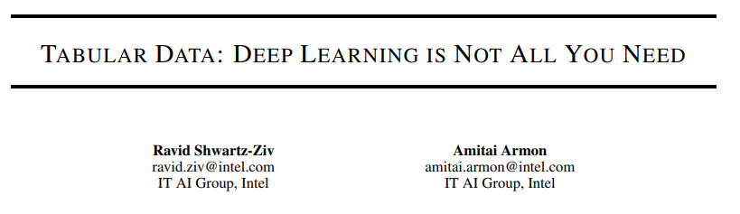
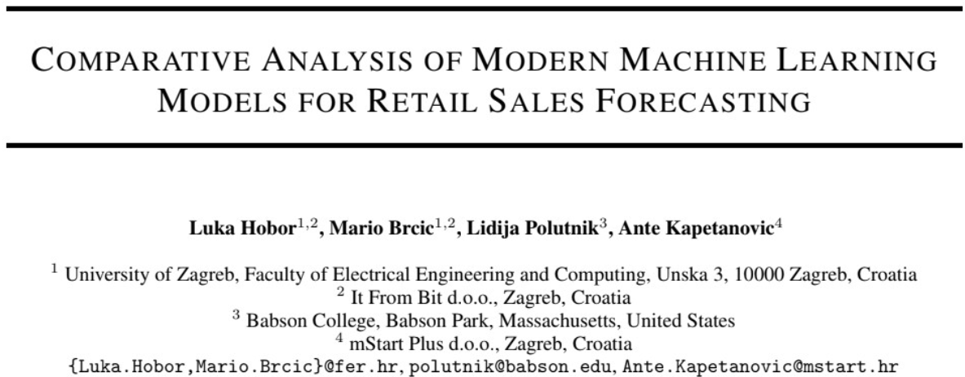
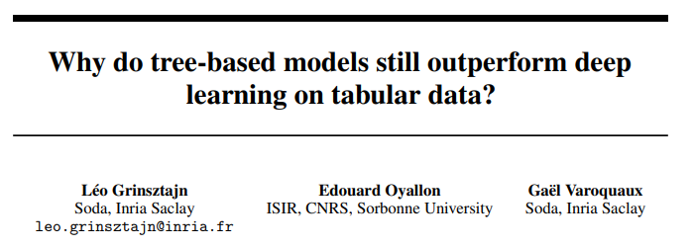
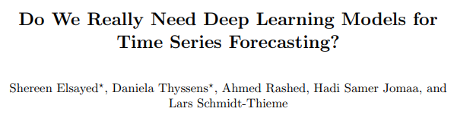
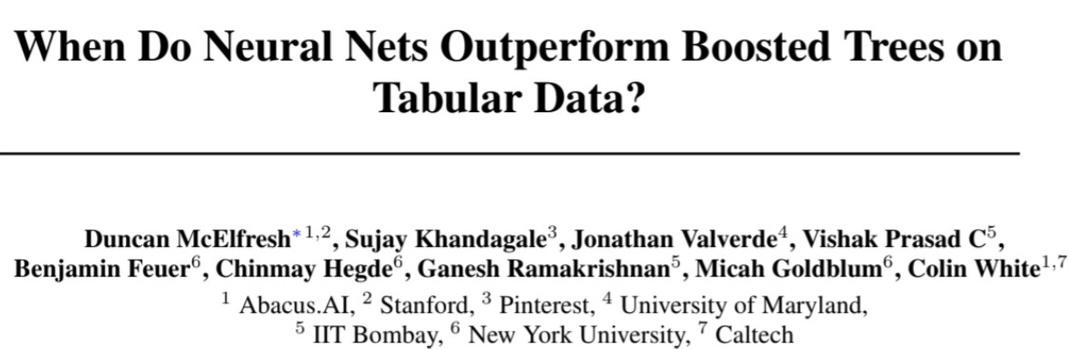
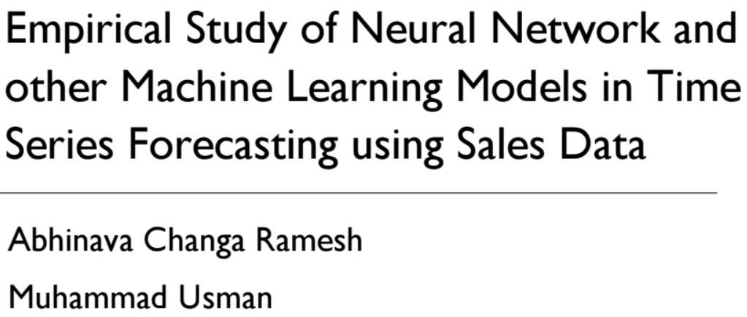
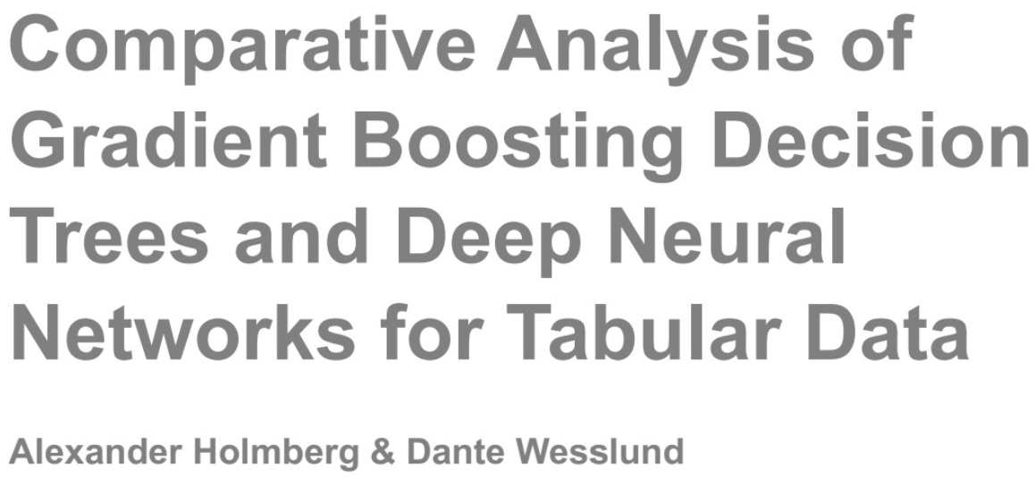
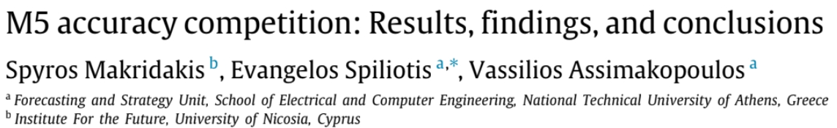
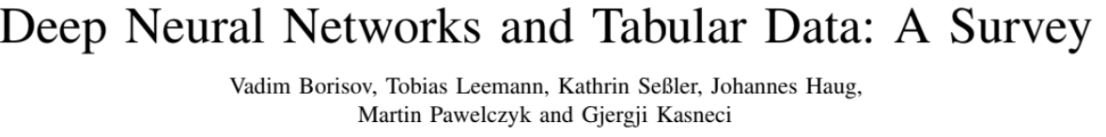
Probabilistic Forecasts with Global Gradient Boosted Decision Trees
“How to Learn”
Per series (local) is limited to lower model capacity
Scaling in width (global) solves that.
This is
Forecasting
Efficiently Scalable Higher Capacity Models
Neural Networks (NNs)
Gradient Boosted Decision Trees (GBDTs)
We focus on Trees. Why?
We have empirical evidence that they work (M5, V1)
People in the industry now they work.
And we have some clue why!
Makridakis, Spyros, Evangelos Spiliotis, and Vassilios Assimakopoulos. "M5 accuracy competition: Results, findings, and conclusions." International Journal of Forecasting 38.4 (2022): 1346-1364.
Januschowski, Tim, et al. "Forecasting with trees." International Journal of Forecasting 38.4 (2022): 1473-1481.
VN1 Forecasting Competition — What I Learned from the Best Forecasters, Nicolas Vandeput medium
Notes:
And here is a bunch of paper from both forecasting and tabular data literature (identical to forecasting as we frame it using ml models)
And yeah, its very fair to argue that guys in Walmart, Amazon, Alibay, Bytedance etc can architect NNs that work expeptionally well for their specific case and outperform GBDTs
Of course, there are super talented scientists and engineers there that can even make prophet work if you ask me.
Plus they have exceptional data collection pipelines to pair every model they decide to work.
But this is just a small % of companies requiring large scale operational forecasts. The general case is that evidence points that GBDTs works better.

Slide 4
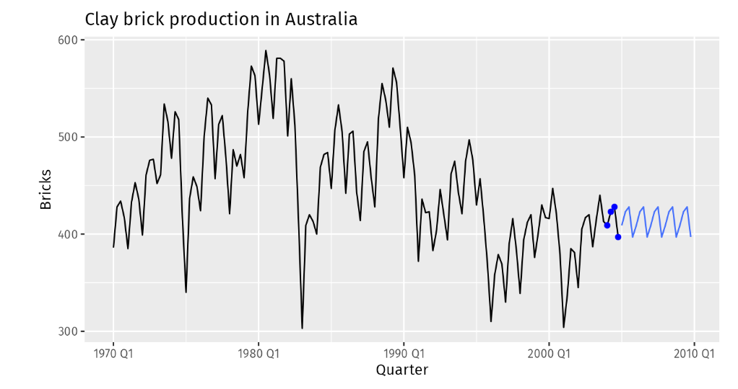


Probabilistic Forecasts with Global Gradient Boosted Decision Trees
This is a point forecast:
In practice it can be “useless”.
It serves as a proxy for models’ performance or as anchor point
Why? Extremely unlikely to get it right.
Parametric uncertainty, model uncertainty etc
And mistakes cost $$
Underforecast
Overforecast
A prediction intervals quantifies the uncertainty, enabling cost-sensitive decision making
Kourentzes, N., Trapero, J.R, & Barrow D. K(2020): Optimizing forecasting models for inventory planning. International Journal of Production Economics, 225, 107597
Notes:
So we need probabilistic predictions.
We need prediction intervals.
What is a prediction interval? A range of values that quantifies the future uncertainty enabling us cost-sentive decision making

Slide 5


Probabilistic Forecasts with Global Gradient Boosted Decision Trees
Research Gap – Aim – Motivation etc, etc, etc
Motivation:
GBDTs are useful in practice
They are designed for point forecasting
We care more for probabilistic predictions
A clear gap:
Most ML Probabilistic estimators are model agnostic
+ they have individual limitations (they all have)
+ they do not consider GBDTs unique capabilities
Aim:
Argue for the compatibility of GBDTs with bootstrapping
Identify limitations & propose targeted adjustments
Discuss results from real world case studies
Notes:
So in this talk I am going to reinvent the wheele and talk about boostraping.
I will make the argument that is compatibility with GBDTs.
I will talk about their limitations and discuss the adjstments we propose
And finally present some results from 4 case studies from the retail sector

Slide 6
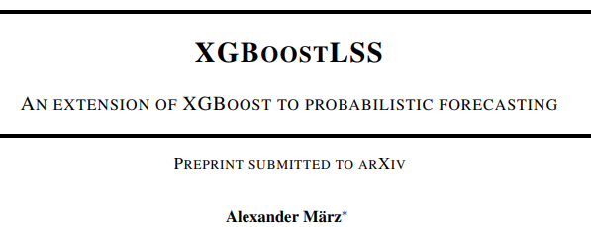
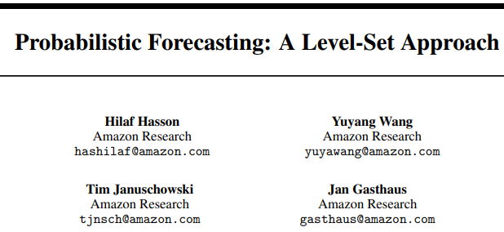
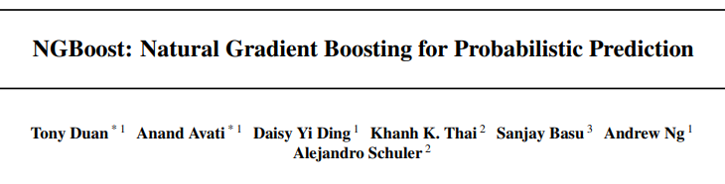
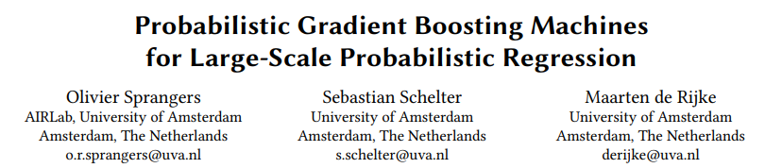
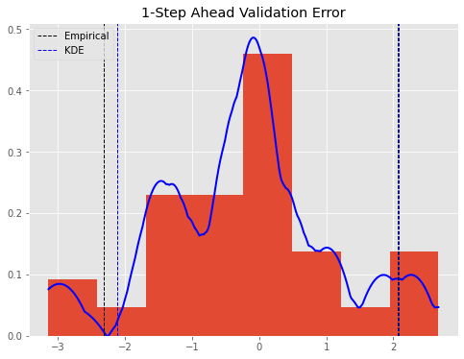
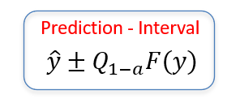
Probabilistic Forecasts with Global Gradient Boosted Decision Trees
A Quick Background Check
(Parametric) distributional GBDTs
Various Approaches
Not as flexible as Deep Learning
Unstable & slow (not all)
Quantile Regression
Ok, this is basic & straightforward. Pinball loss!
Does not guarantee monotonicity
No local dependencies
Non-Parametric Methods (Empirical Methods)
They existed before “Conformal Predictions”
Good for local corrections
Assumes history will be repeated
Trapero, J. R., Cardos, M., and Kourentzes, N. (2019). Empirical safety stock estima-tion based on kernel and garch models. Omega, 84:199–211.
Angelopoulos, A. N. and Bates, S. (2021). A gentle introduction to confor-mal prediction and distribution-free uncertainty quantification. arXiv preprintarXiv:2107.07511.
Stankeviciute, K., M Alaa, A., and van der Schaar, M. (2021). Conformal time-seriesforecasting. Advances in neural information processing systems, 34:6216–6228.
Notes:
Finally we have non parametric empirical methods.
You know we have a distribution of errors, we extract a quantile and sum it up and down to our point forecast
Suprirse surprise they existed before conformal predictions
Biggest problem is that they assume (among others) that future errors will be identical to future ones.

Slide 7
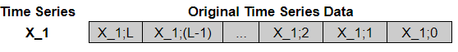

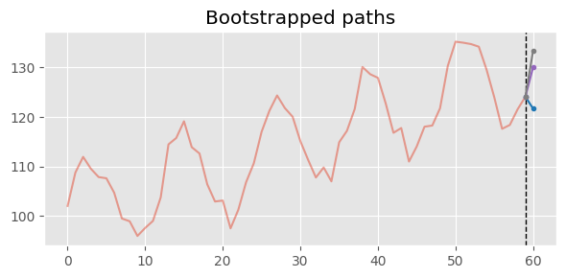
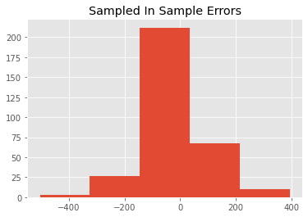
Empirical Local Inference
Autoregressive Inference with Global Learning
*
…
y1
y2
Optimized globally
Model has limited local information
But errors have local patterns!
Bootstrapping with GBDTs
y1 +ε
Sample error ε
Some Empirical LOCAL error distribution
Notes:
You see some examples

Slide 8
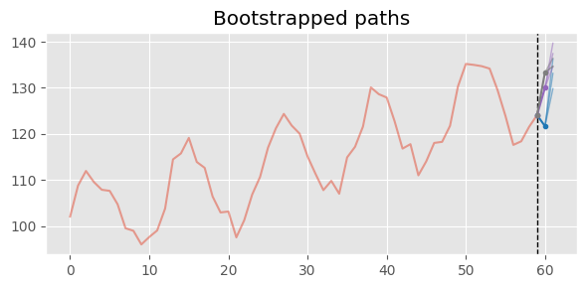
Empirical Local Inference
Autoregressive Inference with Global Learning
*
…
y1
y2
Optimized globally
Model has limited local information
But errors have local patterns!
Bootstrapping with GBDTs
y1 +ε
y2 +ε
Sample error ε
Some Empirical LOCAL error distribution
Notes:
Then on the next step, we provide the context window (with the added error) and we sample again
So we generate more paths.

Slide 9
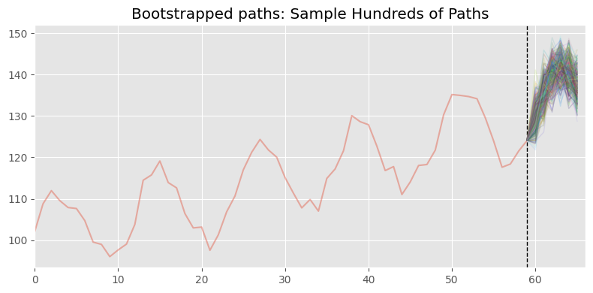
Empirical Local Inference
Autoregressive Inference with Global Learning
*
…
y1
y2
Optimized globally
Model has limited local information
But errors have local patterns!
Bootstrapping with GBDTs
…
y1 +ε
y2 +ε
y12 +ε
Some Empirical LOCAL error distribution
We build local distributions that simulate scenarios based on past local errors
(based on every simulated autoregressive error combination)
Notes:
So through local inference we build local distributions that simulate scenarios based on past errors.

Slide 10
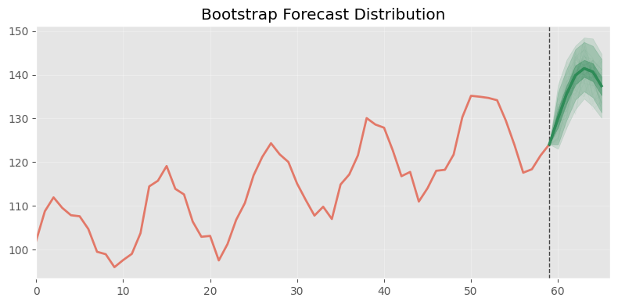
Empirical Local Inference
Autoregressive Inference with Global Learning
*
…
y1
y2
Optimized globally
Model has limited local information
But errors have local patterns!
Bootstrapping with GBDTs
…
y1 +ε
y2 +ε
y12 +ε
Some Empirical LOCAL error distribution
We build local distributions that simulate scenarios based on past local errors
(based on every simulated autoregressive error combination)
Notes:
And we end up with this nice distribution

Slide 11
Pairing Bootstrapping with GBDTs
Our argument:
Bootstrapping is a local correction for global models
Aligned with the autoregressive nature of GBDTs
Residual shock & error accumulation is mitigated by GBDTs architecture (Especially if trained on augmented datasets)
With sufficient simulation we get stable, calibrated and meaningful paths that simulate every possible scenario (Or at least we assume so)
The problem?
Bootstrapping requires more assumptions that do not (necessarily) hold in practice for all time series.
Notes:
Ok we have on problem, that boostraping have many assumptiosn that do not work so well in practice.
So these are what we aim to change here.

Slide 12
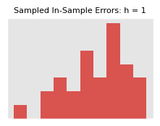
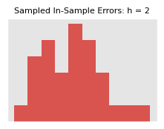
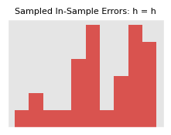
Rethinking Bootstrapping with Structural Adjustments
Bootstrapping Scheme
Bootstrapping assumes i.i.d errors
Temporal dependencies are not accounted
For multi-step forecasts the assumption fails
y1+ε
y2+ε
…
yn+ε
Solution: Multi-step-ahead bootstrapping
Get error distribution for every h
Sample from the correct distribution
Distributions with reduced samples
The tradeoff: To incorporate temporal dependencies we sampled from shrinked distributions
Note -> There is another assumption here:
Multi-step bootstrapping also does not account for dependencies among the same horizon
Possible alternative: Block Bootstrapping
Cordeiro, C. and Neves, M. (2006). The bootstrap methodology in time series fore-casting. Proceedings of CompStat2006, pages 1067–1073.
Paparoditis, E. and Politis, D. N. (2001). Tapered block bootstrap. Biometrika,88(4):1105–1119.
Notes:
We also have another issue. Blcok boostraping does not account for tdependencesi between the same horizon.
We can use block boostraping, but the distribution gets even smaller.

Slide 13
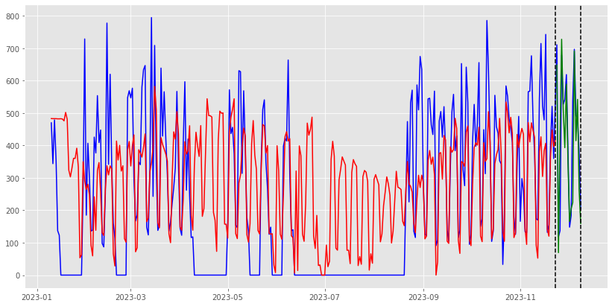
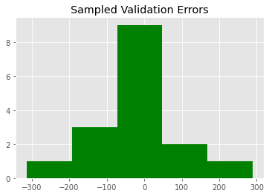
Rethinking Bootstrapping with Structural Adjustments
Set of Errors
Using in-sample errors:
Assume future errors will be similar to historical
GBDTs are prone to overfitting
Underestimates uncertainty -> narrow intervals
Does not capture distribution drifts
Solution: Use validation-set errors (split-conformal)
Sample from validation errors
More realistic reflection of future errors
Distributions with reduced samples
(especially with multi-step bootstrapping)
The tradeoff: To sample more realistic errors we have to shrink the residuals pool
Hyndman, R. J., Koehler, A. B., Snyder, R. D., and Grose, S. (2002). A state spaceframework for automatic forecasting using exponential smoothing methods. Inter-national Journal of forecasting, 18(3):439–454.
Xu, C. and Xie, Y. (2023a). Conformal prediction for time series. IEEE Transactionson Pattern Analysis and Machine Intelligence, 45(10):11575–11587.
Notes:
So again, the same tradeoff. To bypass the assumption you will have reduced pool of errors

Slide 14
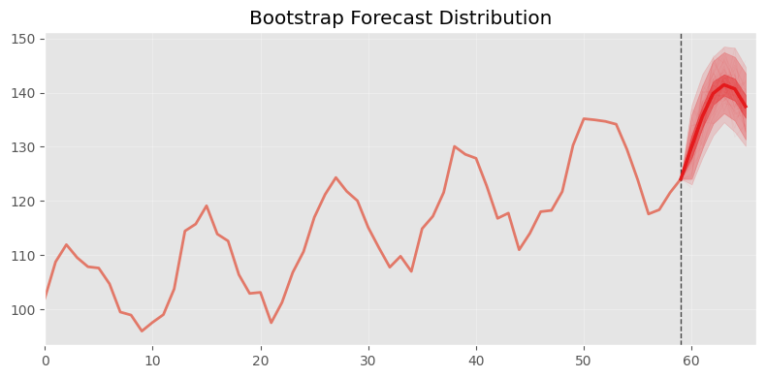

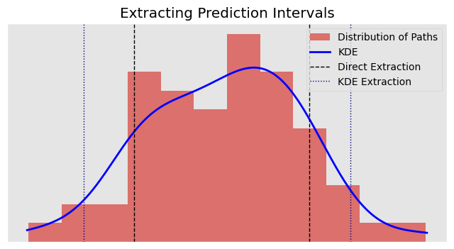
Rethinking Bootstrapping with Structural Adjustments
Extracting Prediction Intervals
The simplest approach:
Straightforward
Unstable quantiles (in tails) with small pool of errors
Requires large and diverse set of empirical errors
Validation and multi-step errors may exacerbate this
The solution: Kernel Density Estimators:
Estimates the probability density function
More smooth distributions (especially for limited samples)
More effectively capture tails
Might lead to over or under smoothing
Allouche, M., Girard, S., and Gobet, E. (2024). Estimation of extreme quantiles fromheavy-tailed distributions with neural networks. Statistics and Computing, 34(1):12.
Trapero, J. R., Cardos, M., and Kourentzes, N. (2019). Empirical safety stock estima-tion based on kernel and garch models. Omega, 84:199–211.
Wkeglarczyk, S. (2018). Kernel density estimation and its application. In ITM web ofconferences, volume 23, page 00037. EDP Sciences.
Notes:
One workaround is kernel density estimators. Similar to Juans and Nikos work here.
We estimate the probability density function and then extract the quantile
This creates more smooth distirbutions, especially for limited samples.
Yes it can lead to over or under smoothing but there is always a tradeoff.

Slide 15
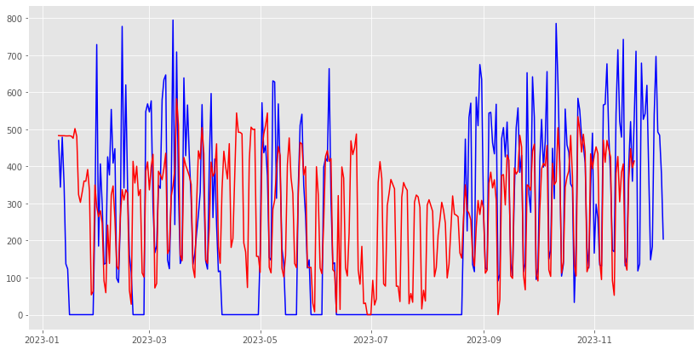
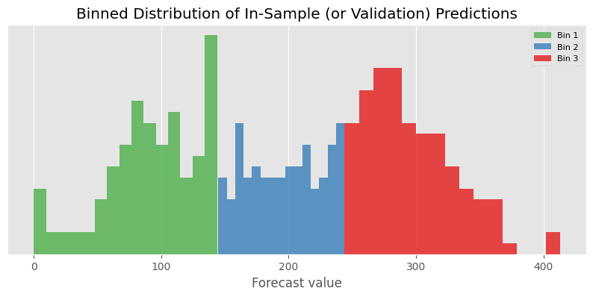
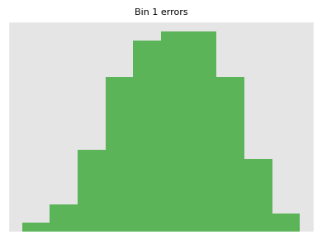
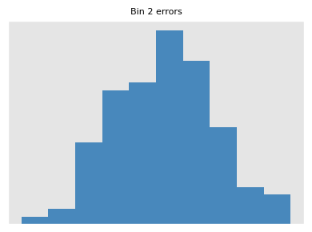
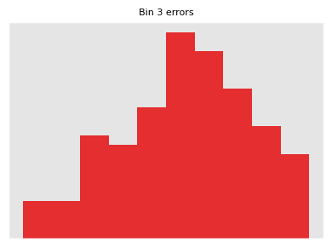
Rethinking Bootstrapping with Structural Adjustments
Binning Errors
Heteroscedasticity in the error’s structure
Methods before do not account for forecast magnitudes
Volume of errors is correlated with magnitude of forecast
Core issue on high volatile items
Solution: Binning errors based on forecast magnitude
Step 1: Bin in-sample or validation predictions into k bins
Step 2: Estimate the error distribution per bin
Step 3: Generate point forecasts and assign to right bin
Step 4: Sample from the bin-specific distribution
Binning errors:
Captures scale-dependent error patterns
Partial mitigation of non-stationarity effect on i.i.d residuals
Error distribution per bin
Amat Rodrigo, J & Escobar Ortiz, J (2025). skforecast (v0.16.0) Zenodo https://doi.org/10.5281/zenodo.15319927
Bergmeir, C., Hyndman, R. J., and Ben´ıtez, J. M. (2016). Bagging exponential smooth-ing methods using stl decomposition and box–cox transformation. Internationaljournal of forecasting, 32(2):303–312.
Notes:
So why we do that? We capture scale dependencies which partially mitigate the non-stationarity effect on i.i.d residulas as outlined here.

Slide 16
Experimental Design
Notations are hard
Bootstrap
Scheme
Conventional (C)
Multistep (M)
Set of errors
Training (TR)
Validation (VAL)
…
Extraction method
Empirical (EQ)
KDE (KD)
…
…
Binning
Binning (B)
No Binning ()
…
…
…
Notes:
Ok let me try to organize the methods and the notations a bit.
Sorry for the names, I guess everyone know how hard they are.

Slide 17
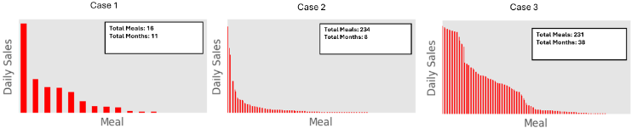
Experimental Design
Real World Case Studies
Three demand forecasting case studies within the food industry (ready-to-eat meals)
Daily demand - forecast horizon is set to 7 days
A total of 5 rolling origins
We use an individually optimized LGBM for each case
Different characteristics (items/length) per case study
Notes:
Ok just describe it here

Slide 18
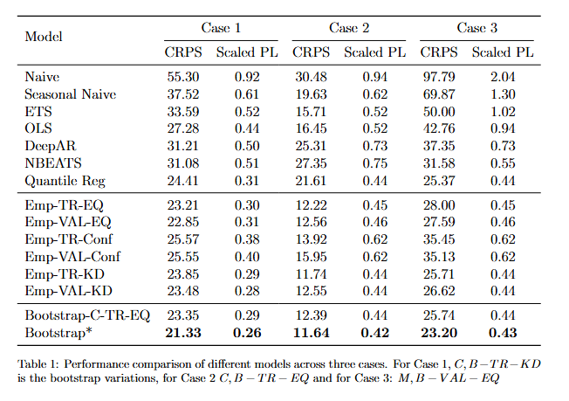
Your Typical Slide with a Table and Some Numbers
GBDTs outperform benchmarks
Conventional Bootstrapping is very competitive validating our initial argument
An adjusted Bootstap method consistently achieves the best score
No single variation is universally better
Modification combinations depend on dataset characteristics
Note:
Bootstrap – C – TR – EQ is the simplest conventional variation
Bootstrap* is the best variation per case
Notes:
Then we have one ouf our methods always performing much better compared to benchmarks. The best method is different per case study and depends on the chatacteristics
I have some more insights later

Slide 19
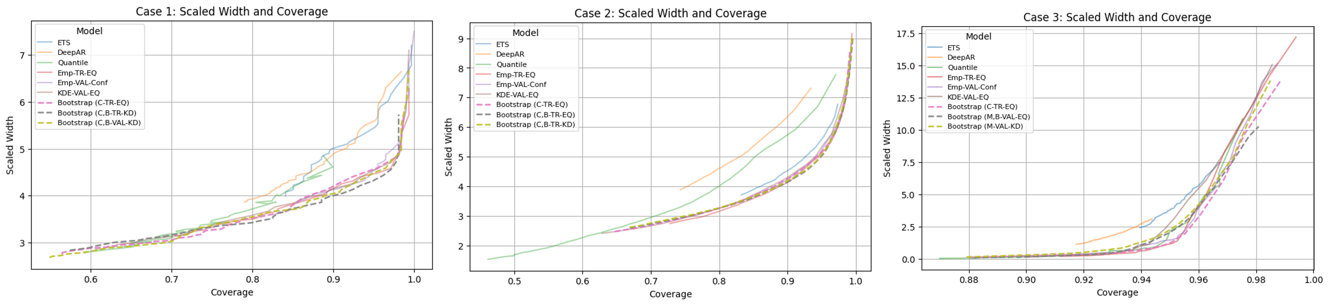
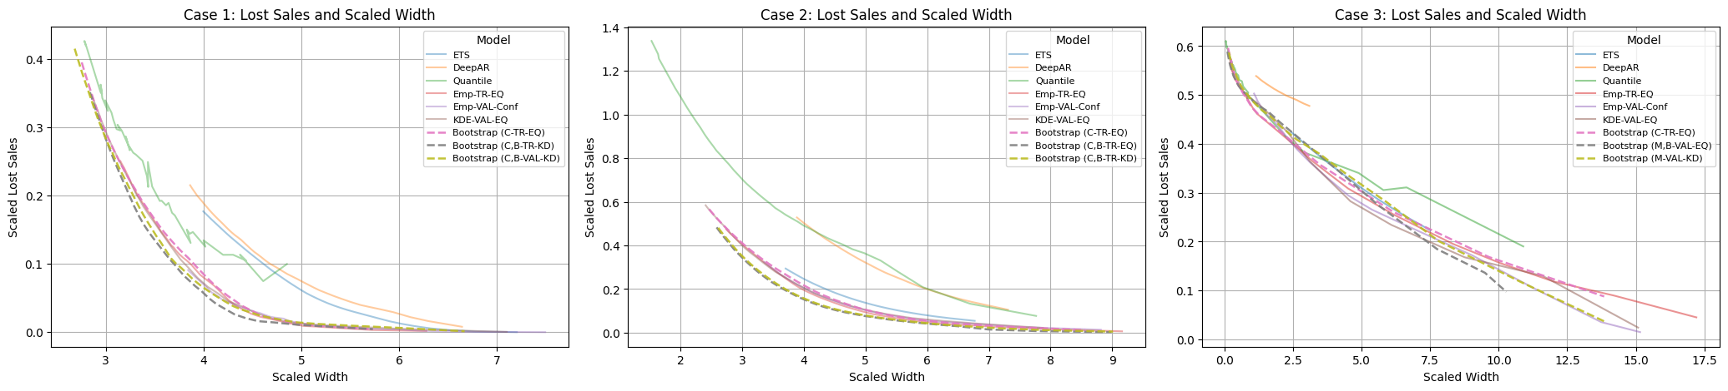
Results
Inventory Simulations
Bootstrap estimators achieve the best tradeoff between sharpness + calibration
Notes:
Some more results from the inventory side.
We have scaled width and coverage on top
We have lost sales and scaled width on the bottom
The goal is to generate sharp intervals while ensuring calibration

Slide 20
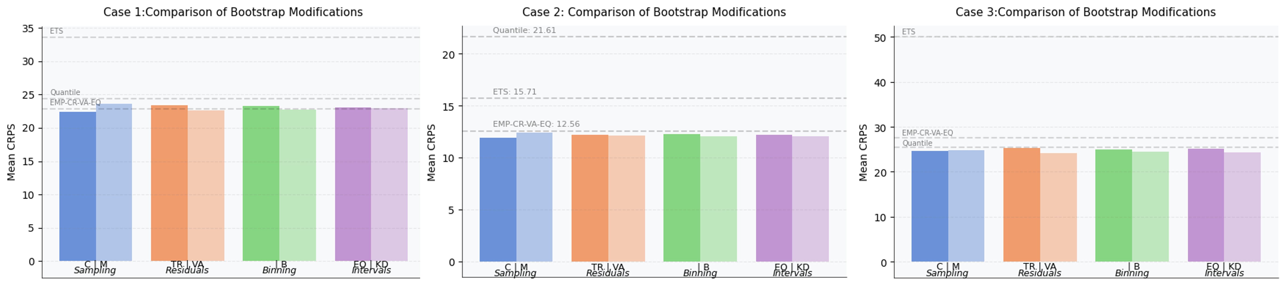
Results
Bootstrap Modifications
Longer series!!
Conventional sampling performs better than multi-step errors
The smaller residual pool hurts more than retaining temporal dependance (Case 3 has longer series)
Notes:
Finding 1: Conventional sampling is always better than using multistep errors.
Why? Because we a small residual pool is more important than keeping temporal dependencies
Exception is Case 3 where we had longer time series, which means we errors per horizon we increased. Still, it does not perform better though

Slide 21
Results
Bootstrap Modifications
Very short series
Limited validation window
Conventional sampling performs better than multi-step errors
The smaller residual pool hurts more than retaining temporal dependance (Case 3 has longer series)
Validation errors either match or reduce the error
They better represent out-of-sample uncertainty, even with very small validation windows
Notes:
Finding too, validation errors are very important.
They match or outperform in-sample residuals. Why? Because they as mentioned they better represent out of sample uncertayinty
In case two we have equal performance which is because we have very short time series so we had to keep a very small validation window

Slide 22
Results
Bootstrap Modifications
Conventional sampling performs better than multi-step errors
The smaller residual pool hurts more than retaining temporal dependance (Case 3 has longer series)
Validation errors either match or reduce error
They better represent out-of-sample uncertainty, even with very small validation windows
Binning errors consistently enhances performance
KDE either matches or improves performance over direct extraction.
Notes:
Two extra findings.
Binning errors consistently enhances performance validating what we said about the importance of considering forecast magnitudes
KDE always either matche or performs better than direct extraction.

Slide 23
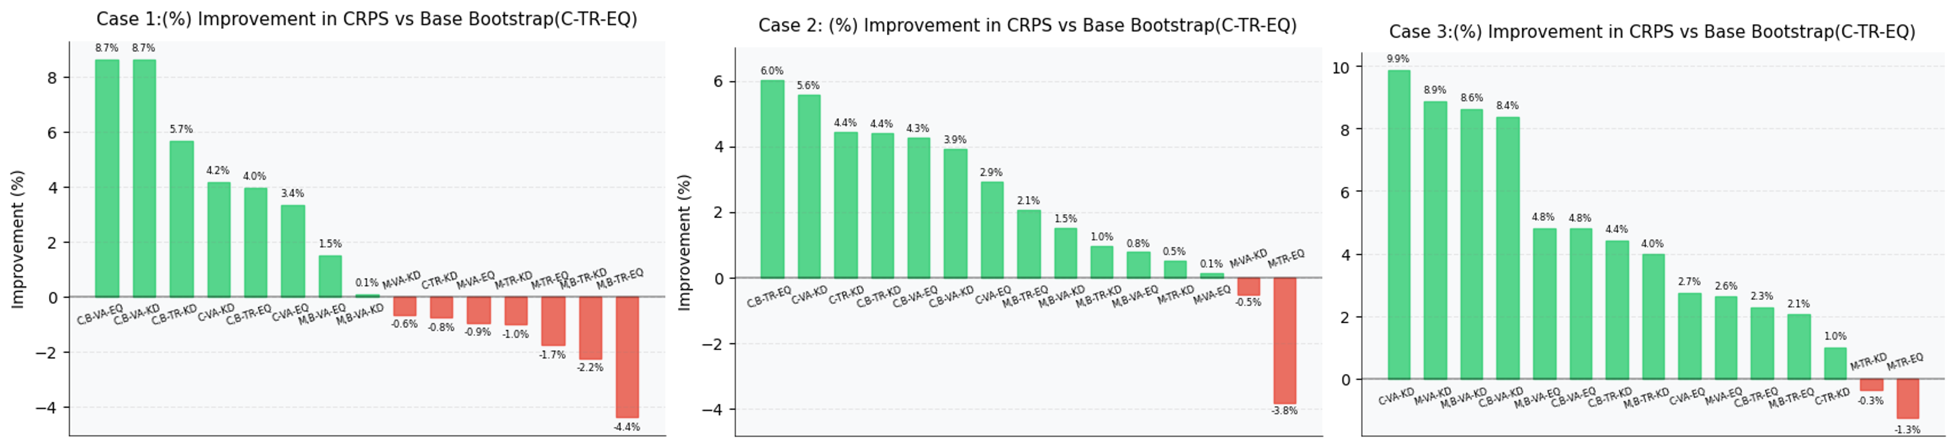
Results
Bootstrap Modifications
Finding 1: KDE smoothing excels with validation set errors
Finding 2: Binning works. Also, KDE requires structured sampling to reach optimal performance
Finding 3: Sample size matter because of the tradeoffs
Notes:
Results: KDE performs very well with validation errors?
Binning again seems to always work. We also find that KDE needs to be paired with binning.
So if we sample from binned validation errors and use KDE to model the distribution we get the biggest improvement.
Finally as we knew, there is no perfect method. Each case has unique characteristics and based on them we have to pick our favourite method

Slide 24
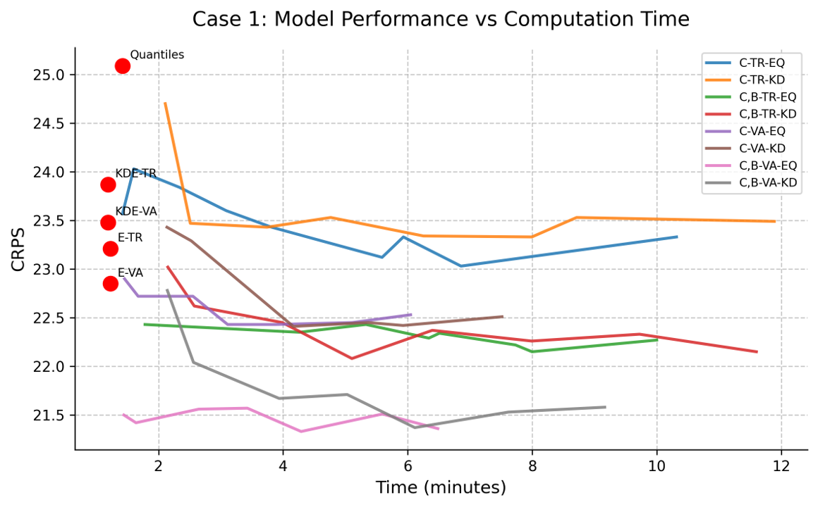
Results
Computation Times
Ok yes, a common limitation of bootstrapping is computational cost
Total Paths
Syntetos, A. A., Babai, M. Z., and Gardner Jr, E. S. (2015). Forecasting intermit-tent inventory demands: simple parametric methods vs. bootstrapping. Journal ofBusiness Research, 68(8):1746–1752
Notes:
Of final slide here. Yes I know boostraping is slow and sometimes we don’t want to spend time on inference. Somf findings here
Dots are static empirical methods. Lines represent number of paths
Increasing the number of paths lower CRPS as expected. Yet, there is a point of diminishing returns
Binned validation errors outperform empirical methods without computational overhead
KDE adds extra computation cost but gives better performance
I have results from Case 1 only here. But the same story holds for all methods!

Slide 25
Summary
Our main argument is that Bootstrapping and GBDTs work well together.
Conventional Bootstrapping comes with some limitations. We propose adjustments.
(As with all things including forecasting) Final method selection depends on a number of factors
Binned residuals with validation-based error selection contributes to the biggest gains
Extraction method depends on the type of errors sampled
Reducing the pool of errors to bypass assumptions is not recommended.
Our methods do not introduce exchessive computational overhead
Notes:
Ok concluding.
We argue that Boostraping and GBDTs work very well together.
Yet, boostraping has some limitations. We propoed a number of adjustments.
Fina method selection is not straightforward, it depends on multiple factors

Slide 26




Thank you for your attention
Questions ?
Gradient!
filotas.theodosiou@vives.be
https://github.com/FilTheo
https://www.linkedin.com/in/filotas-theodosiou/
©mrsiraphol

